Slide 1

Black Box System
Group 13

Slide 2
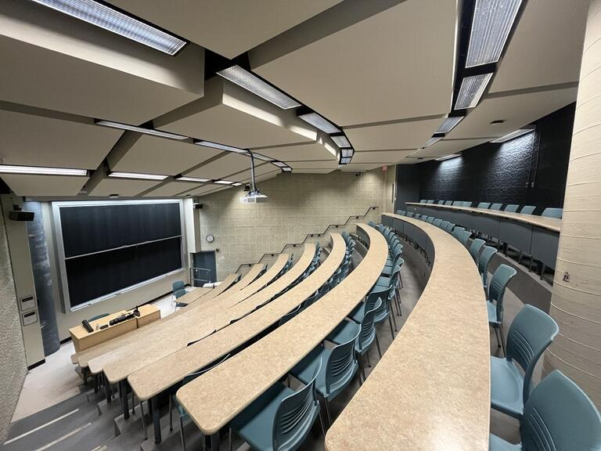
How are you feeling? Warm? Cold? Uncomfortable?

Slide 3


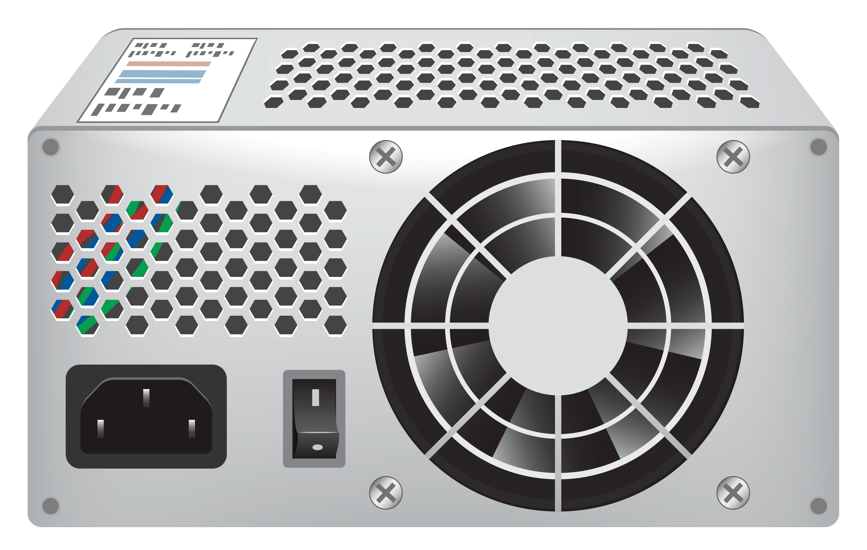
The Application Problem
Goal: Regulate the power drawn by the temperature control despite power consumption changes
Input: Desired electrical power drawn by the control
Output: Actual electrical power drawn by the control

Slide 4




Stakeholders
Occupants
Facility Staff
Maintenance Staff
Institution/Society

Slide 5
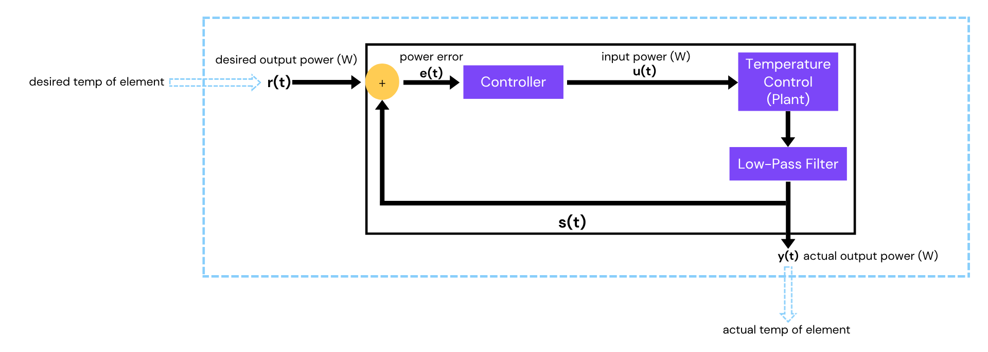
System Diagram

Slide 6
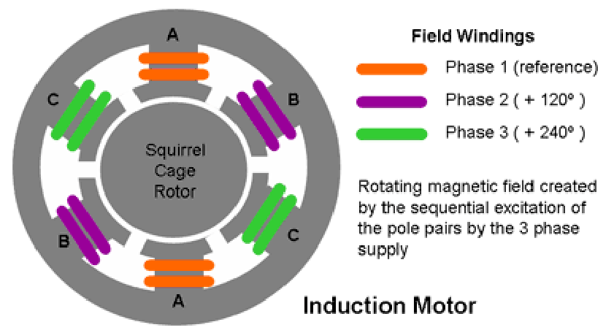
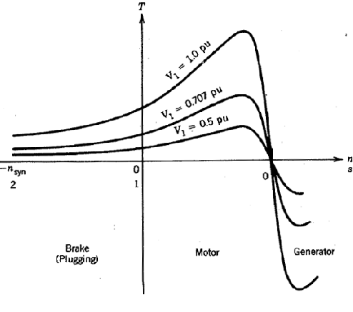
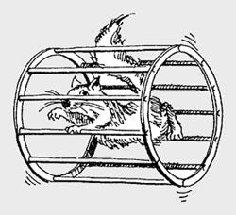
SCIM – A Brief Overview
Three-Phase Motor common in many applications [1]
Induces a magnetic field in the rotor causing rotation, causes heavy current draw on startup [1]
Due to magnetic saturation and slip factor not a fully linear [1]
We will Assume linearity around a steady state operating point for out system
[1] Y-F.Lui, S.Whitehall ELEC 333 Chapter 5: Induction Machines

Slide 7
Proposed Mathematical Solution

Slide 8
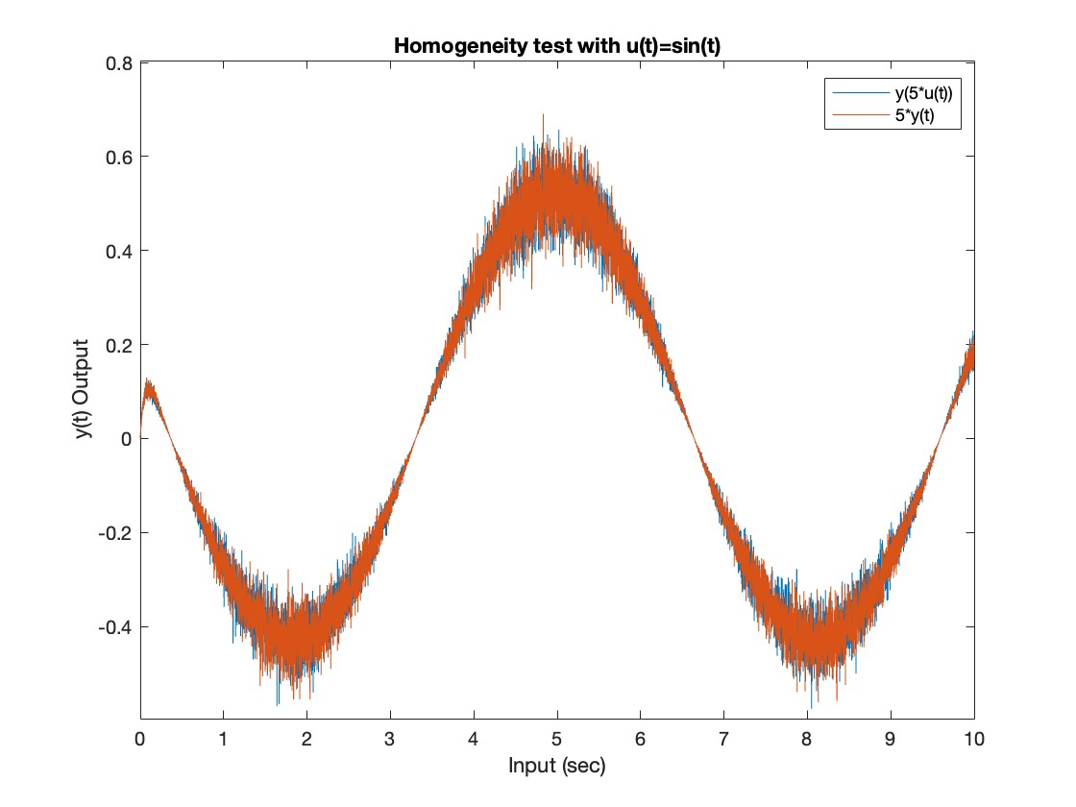
Validating LTI Assumption
Started by assuming that our system is linear time-invariant, then running tests on the system to verify that the following LTI properties hold:
Homogeneity
If the desired power inputted to the system is scaled, it would make sense for the power drawn by the system to scale the same amount. This property was tested on the right.

Slide 9
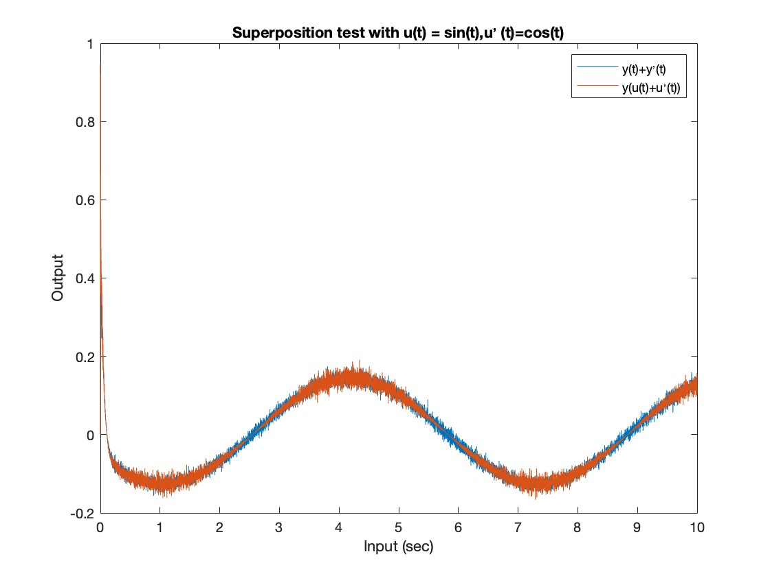
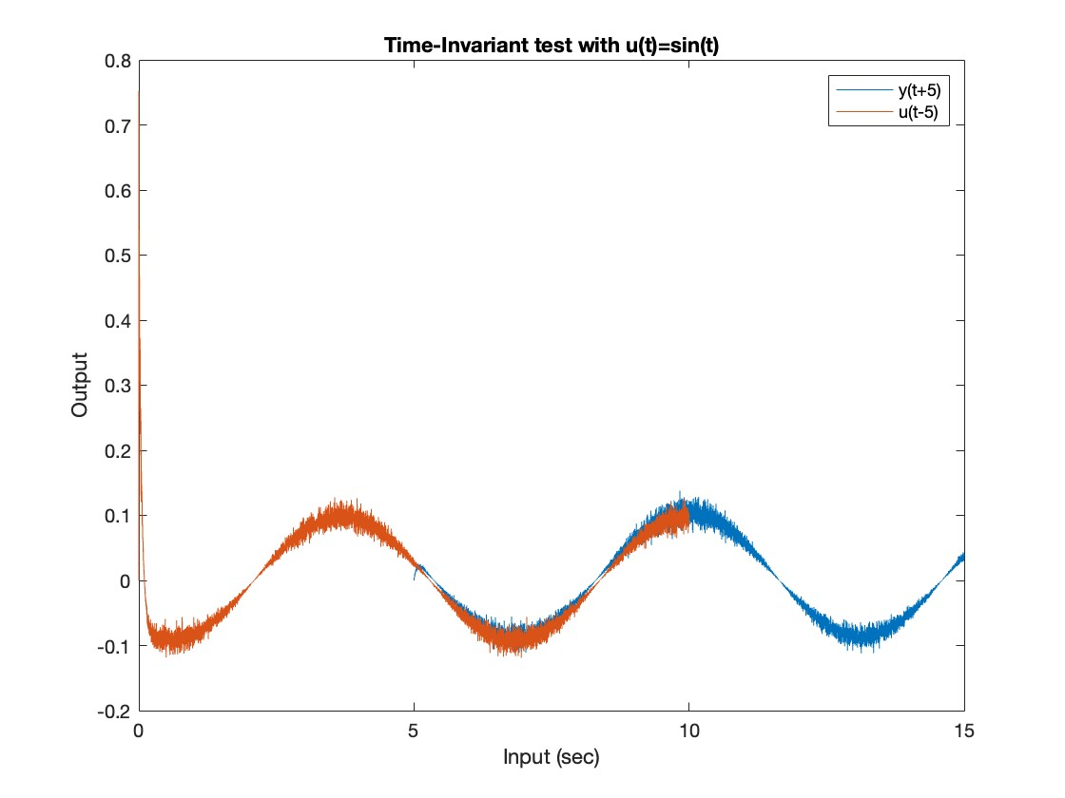
Validating LTI Assumption (cont.)
Superposition
If two different desired powers are summed into the system, the change in outputted power would be the sum of the individual desired powers.
Time-invariance
No matter the time the desired power was changed, the system should respond the exact same. This was demonstrated below.

Slide 10
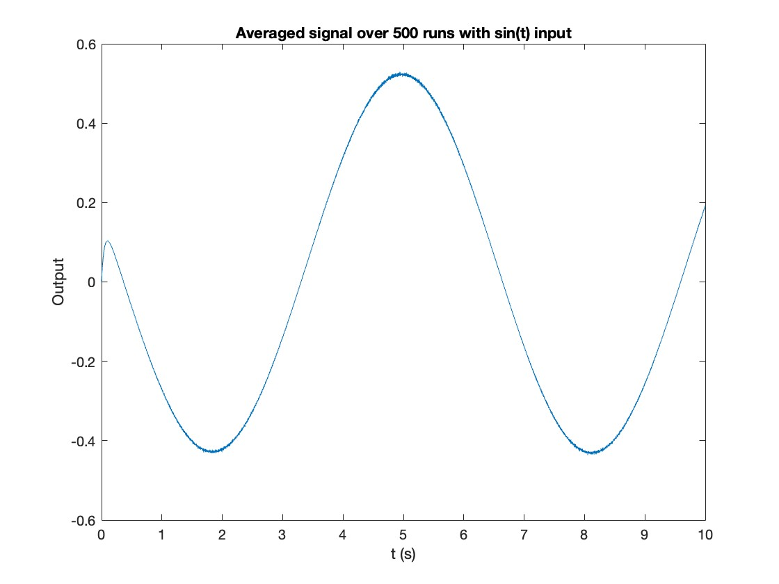
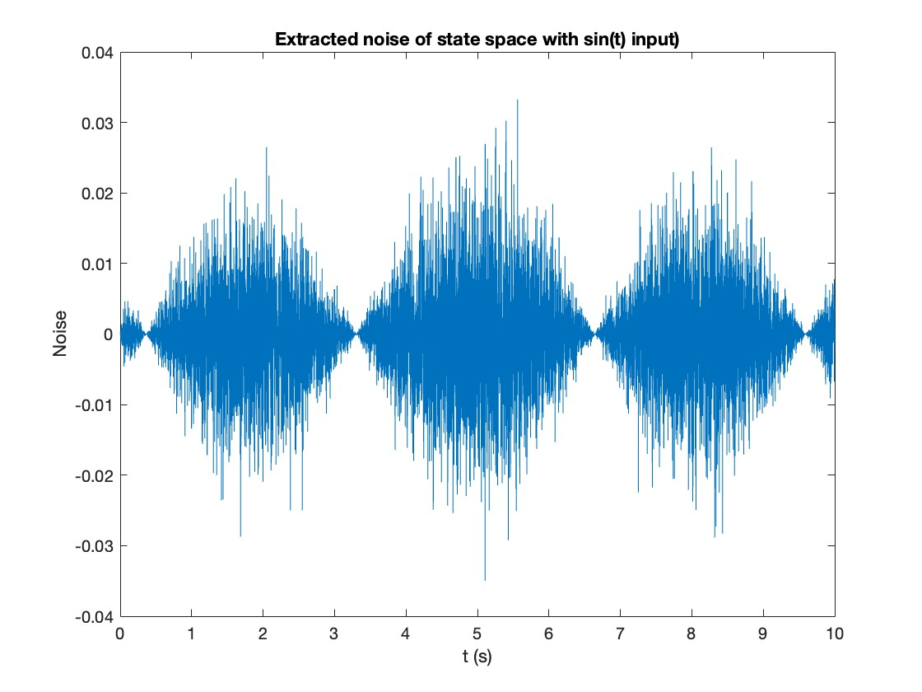
Extracting system noise
Power was inputted into the system as a sin(t) and the experiment was run 500 times
Averaged to create an ideal output power of the system
Noise was extracted from data by subtraction
The correlation between the averaged signal and the noise is 0.534

Slide 11
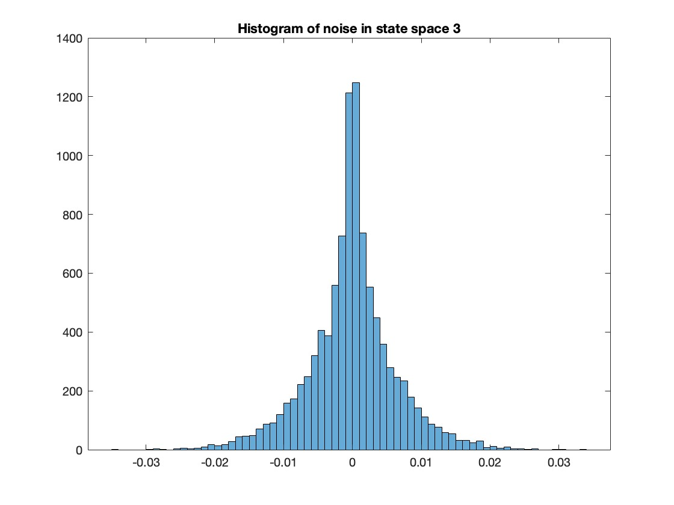
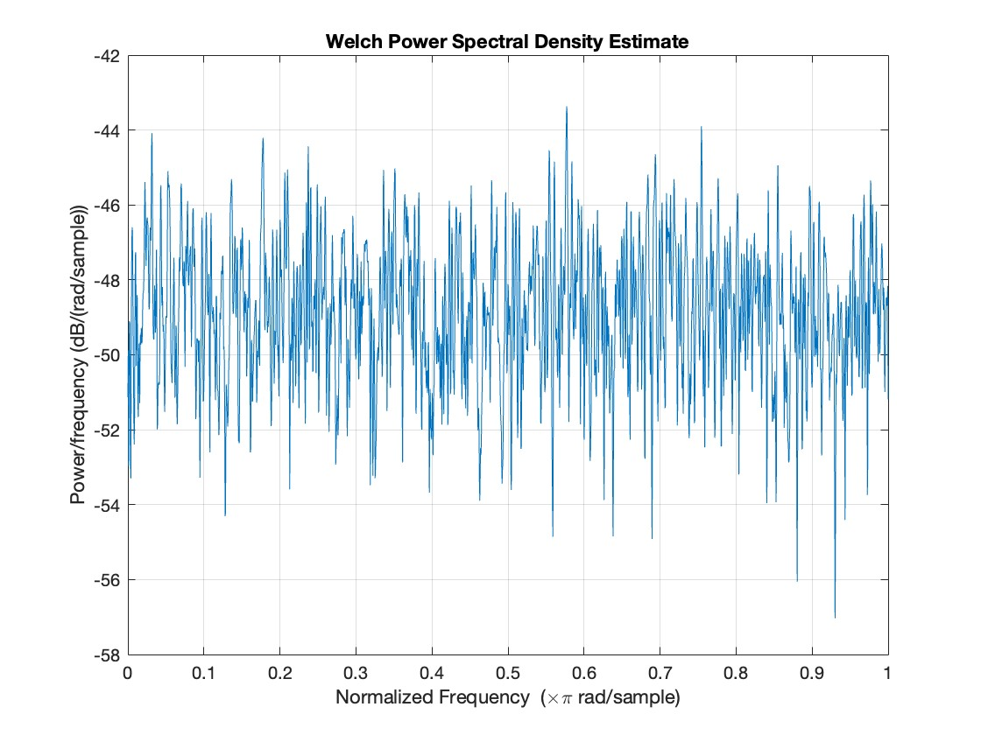
Characterising noise
Using Welch power spectral density estimate, we can see the noise is not applied evenly over all frequencies, hence the noise is not white.
Next a histogram of the noise was taken, which formed a sharp bell curve. This showed that the noise was gaussian.
This kind of noise could be produced by inefficiencies in the fans and compressor​ or errors in the measurement tools.

Slide 12
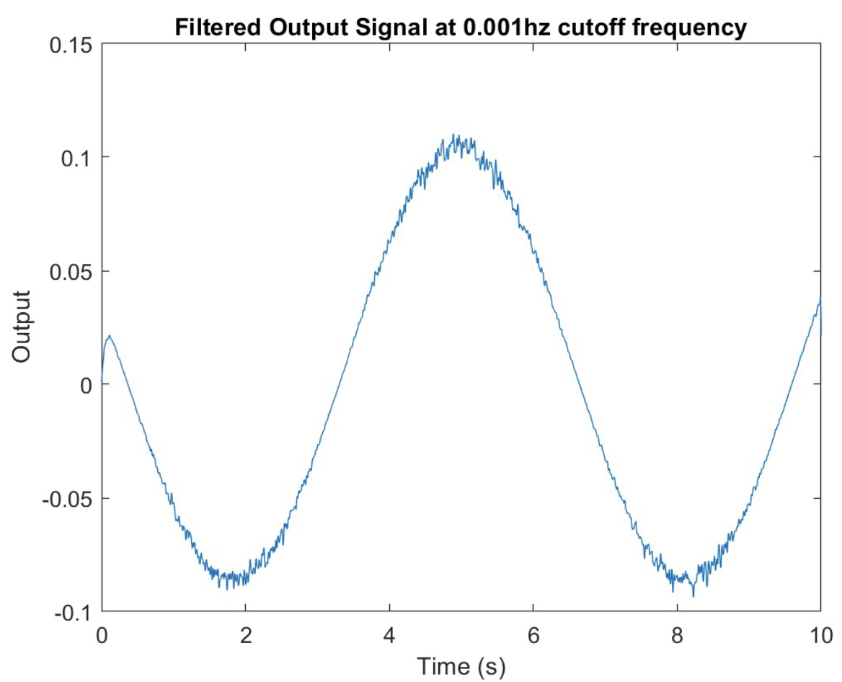
Filtering
Many different filters were tried
Best results came from a cutoff frequency of 0.001 Hz using a low-pass filter on the outputted power
RMSE of ±0.0016 with the averaged power drawn
Spikes in power drawn from the motors will not throw the system into chaos, focusing more on the overall power drawn

Slide 13
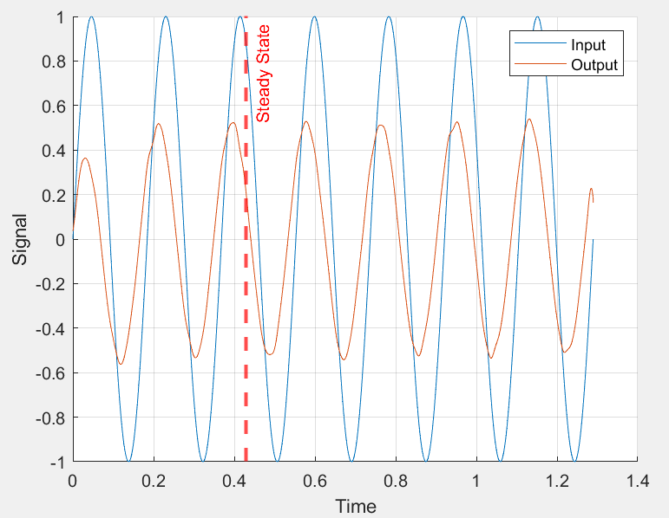
Frequency Response
To model the system effectively, we plotted the frequency response of the system
Pure frequencies applied as input voltage
Gain and phase shift measured for each input frequency
Bode plot showing this relationship next slide

Slide 14
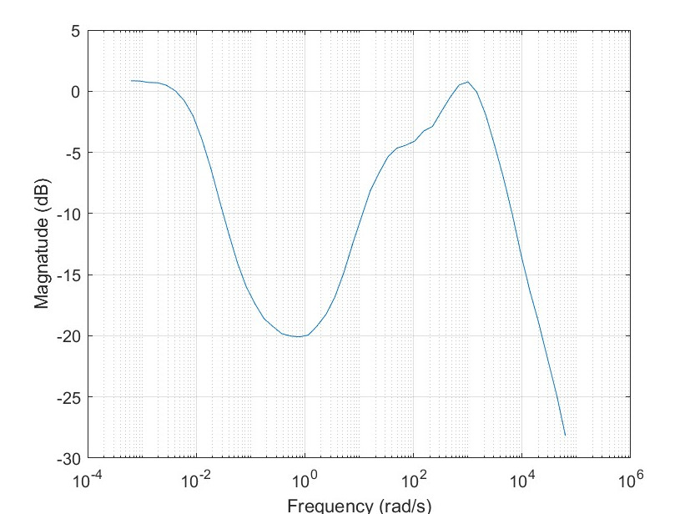
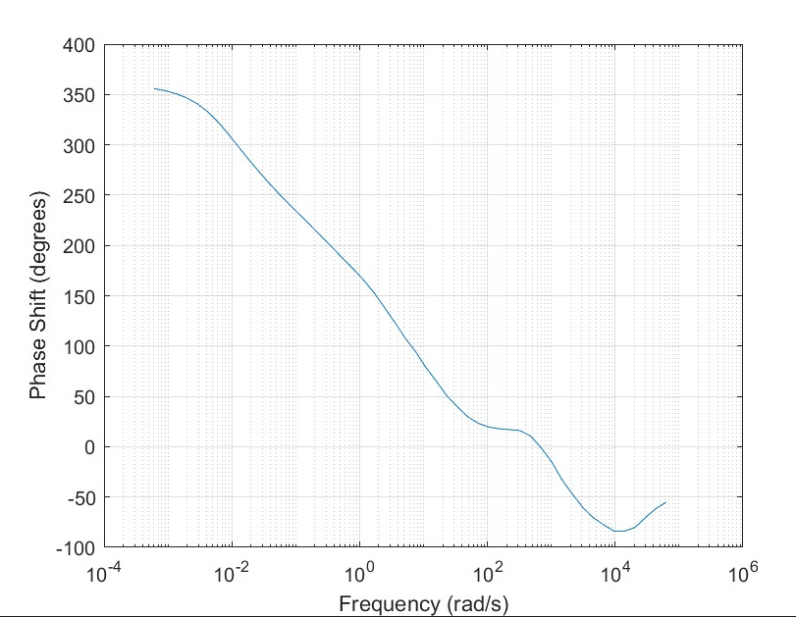
Bode Plot of System

Slide 15
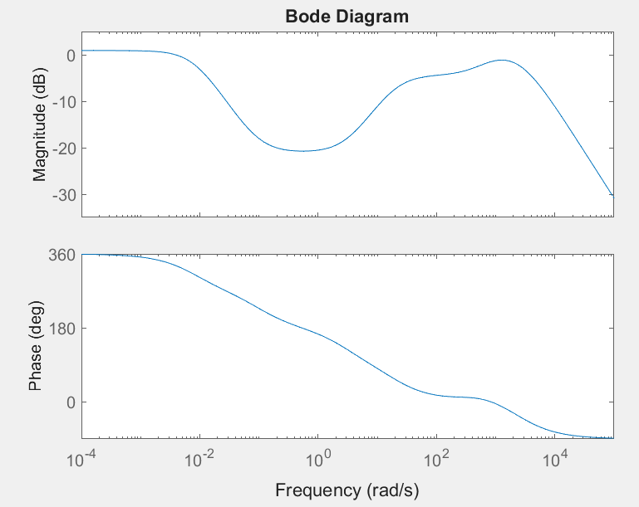
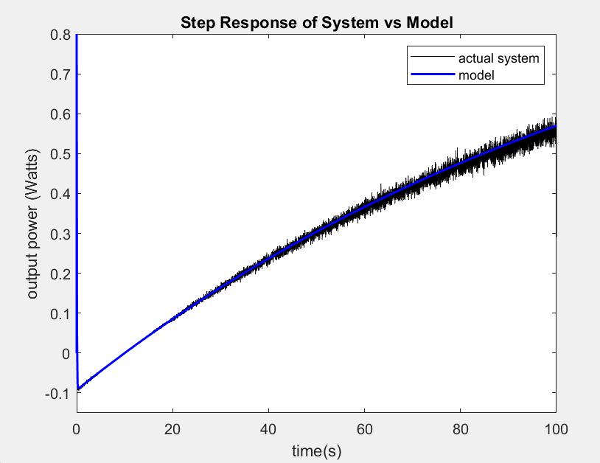
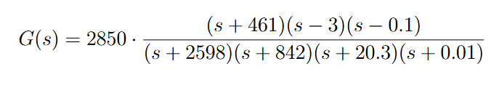
Modelling The Transfer Function
As the electrical system is assumed to be LTI it is modelled with a zero-pole gain transfer function
Initial zeros and pole locations estimated from Bode plot
Parameters varied to match systems Bode plot and step response
Note the system dynamics and transfer function model both indicate a non-minimum phase system
Bode Diagram of Model

Slide 16
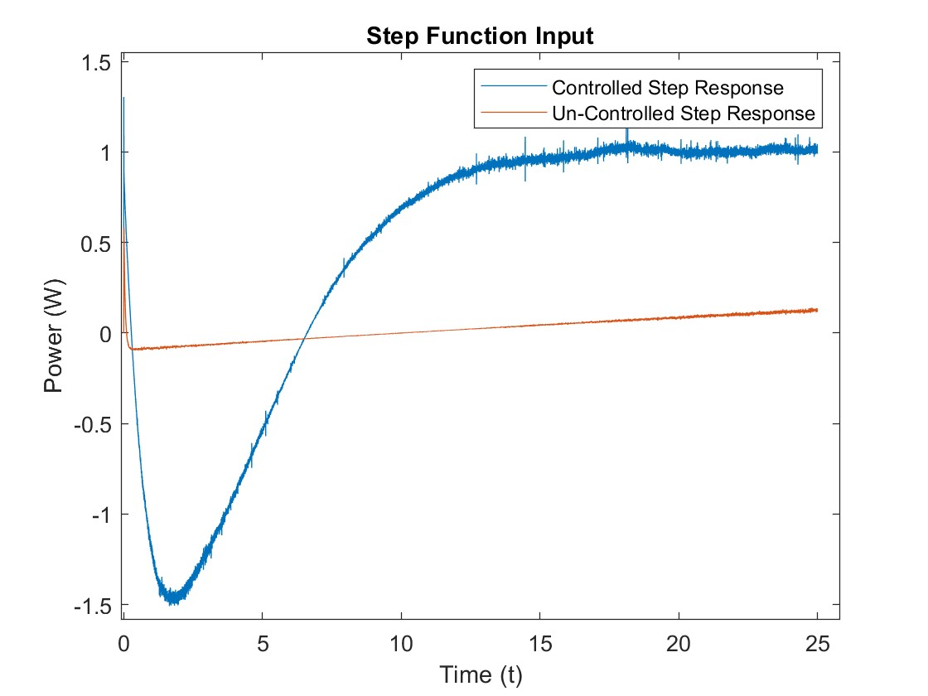
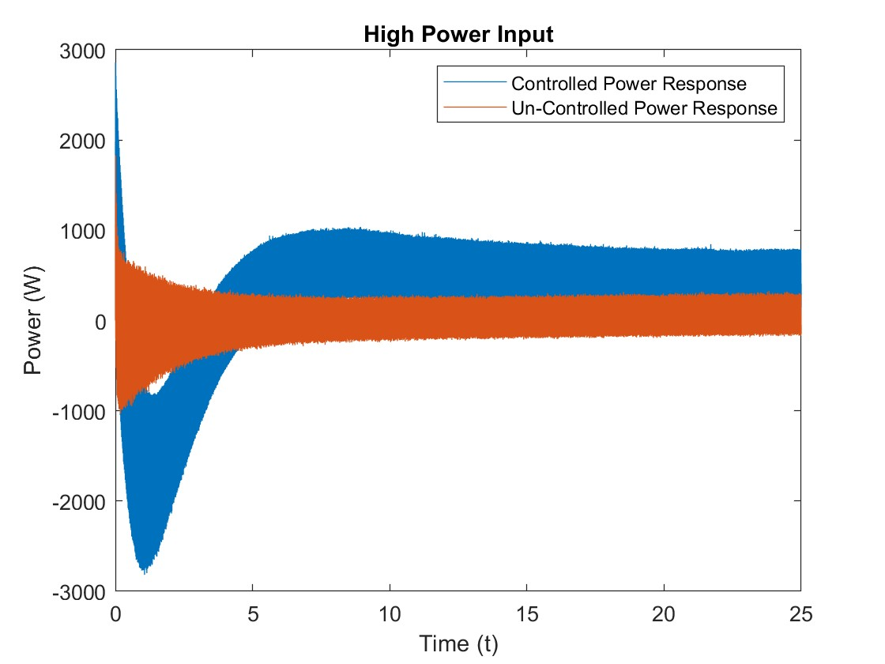

Controller Design
Comparison with exponential decay to model startup power draw.
Note Rise time control vs uncontrolled.
Note for overcurrent draw about 6 times rated power is standard. [1]
Steady State Offset | Rise Time | Over-shoot | Settling Time | Settling (з)
0.04 | 12.5s | 0 | 13s | 0.09
[1] A.Lee and C.Flinn (2020) Basic Motor Control I.3

Slide 17
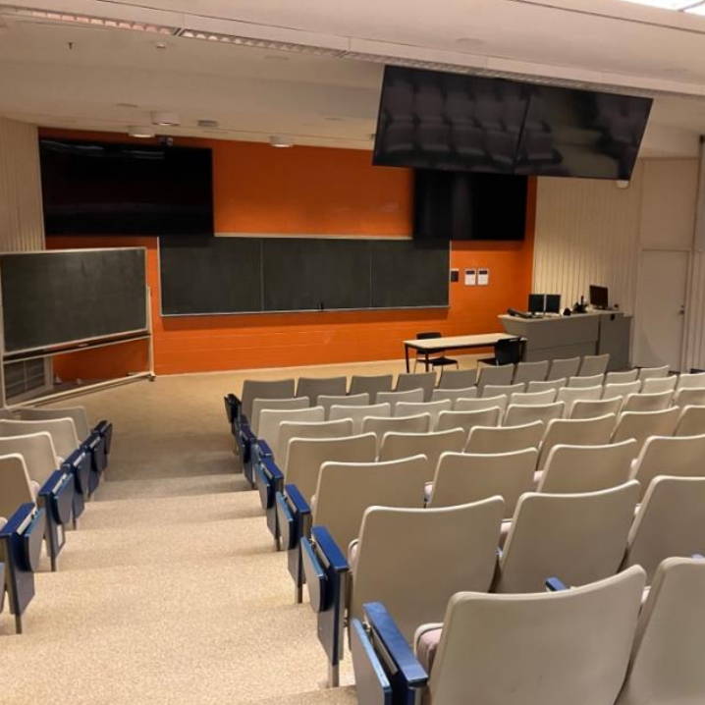
Triple Bottom Line Analysis
Notes:
For our triple bottom line, we choose to evaluate it in terms of a real world application. ie the impacts of applying our system to control the room temperature in Dupuis auditorium, a room notorious for students and facility over heating
For our triple bottom line, we choose to evaluate it in terms of a real world application the impacts of applying our system to Dupuis auditorium, a room notorious for students and facility over heating

Slide 18


Statistics
Dupuis Auditorium can house 217 student, at 60% capacity that’s 130 people [2]
At rest the average human body releases approximately 100 watts of energy in the form of heat over the course of 1 hour [1]
In a room with low ventilation this heat load collects, steadily raising the room temperature
[1] Science Insights, How Much Heat Does a Person Generate Per Hour?
[2] Queen’s University, Dupuis Hall Classrooms
Notes:
We started by analyzing how the lecture hall is actually used. Given that the room hosts on average 5 to 7 classes a day, if we assume each class has 60% capacity and Each person gives off about 100 watts of heat then over the course of just one hour the room temperature rises to from 22 to 27 degrees.
We started by analyzing how the room is actually used. Given it hosts 5 to 7 classes a day if we assume each class has 130 people and Each person gives off 100 watts of heat then over the course of one hour the room temperature rises to from 22 to 27 degrees.

Slide 19
Problems We Sought to Address
Effect on Learning and Health
Over heating leads to discomfort, fatigue and reduced concentration [3]
Wasted Energy
With this room alone the university wastes approximately $15 a day in wasted energy costs from overheating [2][4]
Safety
With 79% of residential energy consumption used for space and water heating the risk overheated elements causing fires and pollution grows with misuse [1]
[1]ASHRAE, Standard 55; Watlow, Best Safety Practices for High-Limit Sensors; [2]E.ON, Let’s Huddle Together
[3] European Commission, Temperature and Learning Impacts
[4]Ontario Energy Board, Electricity Rates
Notes:
This creates problems across all three areas of the triple bottom line.
Socially, even a 1 degree increase above ideal room temp can reduce learning performance by about 2 percent, so a hotter room makes it harder to focus.
our system will minimize the difference, improving focus, concentration, and comfort of all in the room
Economically, the HVAC system is still heating the room as if it were empty, which leads to about 15 dollars per day in wasted energy.
our system will cut this cost, and If the university applys it on large scale, has the potential to save hundreds a year in expenses
Environmentally, all of this extra heating is unnecessary. It wastes natural resources used for power generation like natural gas creating unnecessary pollution and degrading the heating equipment faster, leading to a fire hazard or early retirement (it ending up in landfills faster)
our system will address and minimize then difference. Saving the university money
Relate it to fire safety !!! Global warming in relation to HVAC for easy planet
Aside from that continue and just finish your little story and that’s fine just write a rough draft

Slide 20

Future Improvements and Considerations
Further tuning to dampen undershoot and reduce strain
Better performing controller design such as predictive control models [1]
Implementation of a “fuzzy control algorithm” to change PID variables in real time [2]
[1] Kennel, Ralph & Linder, A. & Linke, Marco. (2001). Generalized Predictive Control (GPC) - Ready for use in drive applications?. 4. 1839 - 1844 vol. 4. 10.1109/PESC.2001.954389.
[2] Bu, W.; Guo, S.; Fan, Z.; Li, J. (2025) Improved Adaptive PI-like Fuzzy Control Strategy of Permanent Magnet Synchronous Motor. Energies , 18, 362.

Slide 21
Thanks!

